Slide 1
Red Challenge Teacher Guide
Brad Lance

Slide 2
Links
Finished Cat & Mouse Game: https://the-t-v1rus.github.io/NinjaChallenges/Build/index Unity Package: https://the-t-v1rus.github.io/NinjaChallenges/UnityPackage/RedChallenge_Package.unitypackage
Student Guide: https://the-t-v1rus.github.io/NinjaChallenges/Guide/RedChallenge.pdf Teacher Guide: https://the-t-v1rus.github.io/NinjaChallenges/Guide/RedChallengeGuide.pdf Completed Unity Package: https://the-t-v1rus.github.io/NinjaChallenges/UnityPackage/RedChallenge_Completed.unitypackage

Slide 3
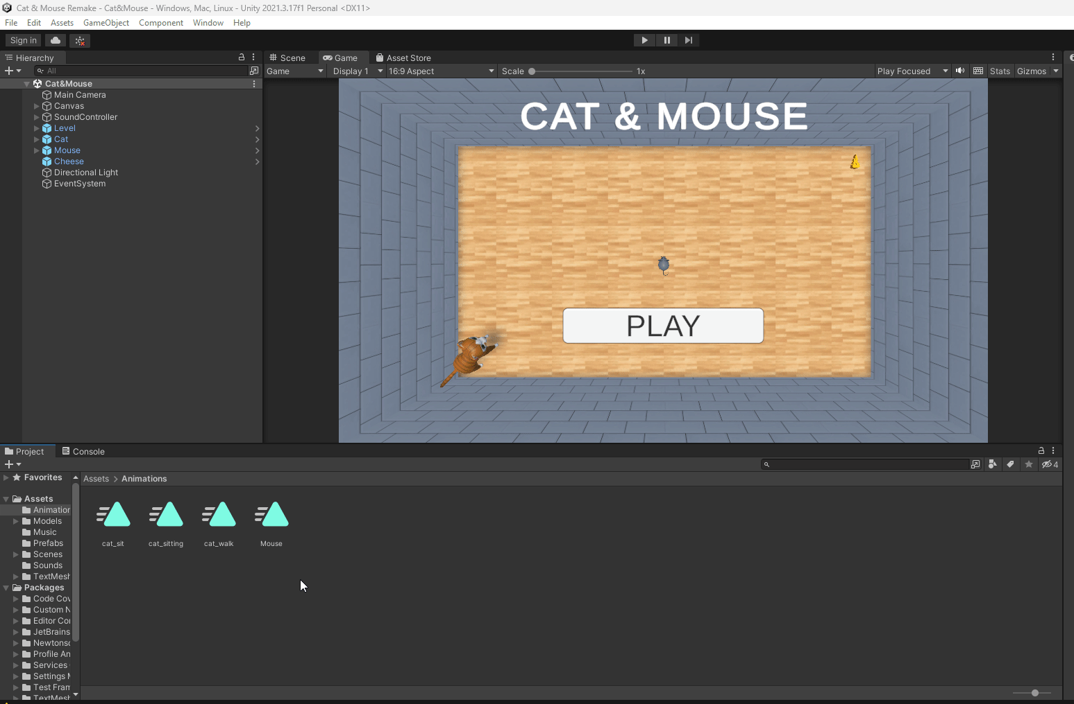
ANIMATE THE MOUSE
Open the “Animations” folder
Find the “Mouse” animation
Drag and drop the “Mouse” animation onto the “Mouse” game object in the Hierarchy
Play the game and make sure the mouse is not wagging its tail

Slide 4
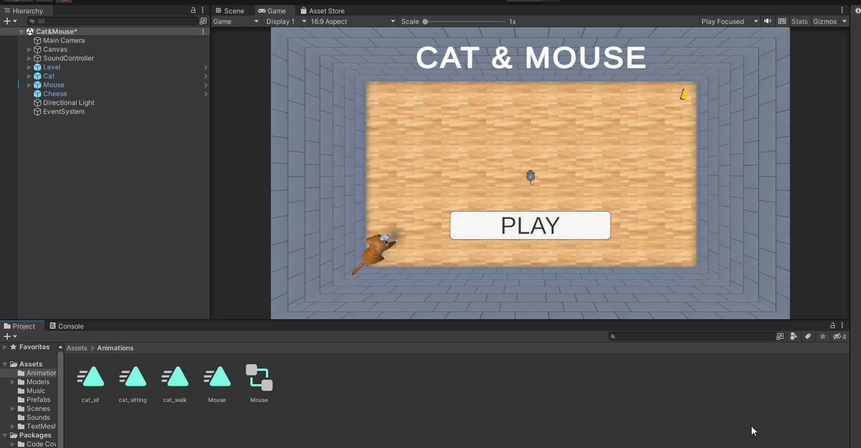
MAKE THE CAT SIT
Open the “Animations” folder
Find the “cat_sitting” animation
Drag and drop the “cat_sitting” animation onto the “Cat” game object in the Hierarchy
Play the game and make sure the cat is now sitting when you play the game

Slide 5
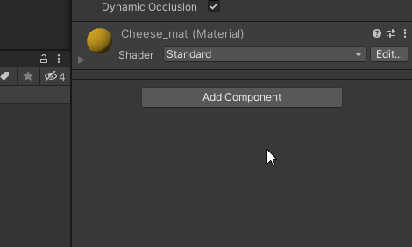
MAKE THE CHEESE ROTATE
NOTE: You can also make a custom animation and add that to the cheese. The method I used to make the cheese rotate was with code.
Click on the “Cheese” game object in the hierarchy
In the Inspector tab, choose “Add Component” and add a new script called “Rotate” to the game object.
Open the script in Visual Studio

Slide 6
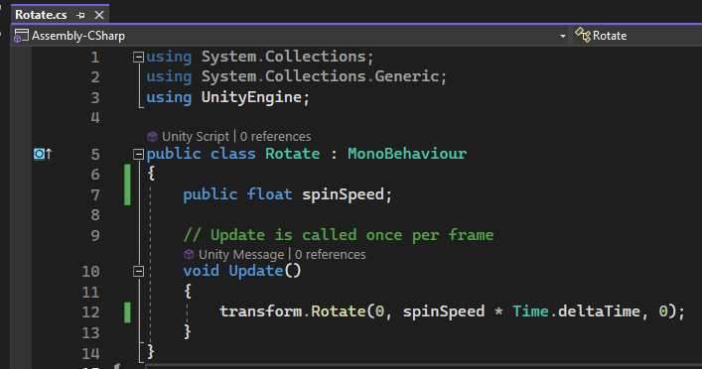
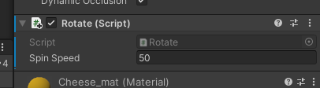
MAKE THE CHEESE ROTATE
Add a variable where we can change the rotation speed of the object
Add code in the update that makes the object spin in the Y axis based on the rotation speed. Make sure the multiply this by Time.deltatime so it will spin at the same speed on all devices
Adjust the spin speed in the inspector tab until the cheese spins at a reasonable rate. The cheese will not rotate until you adjust the spin speed in the inspector tab!

Slide 7
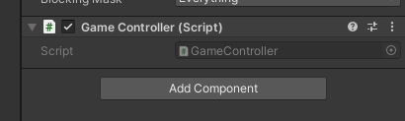
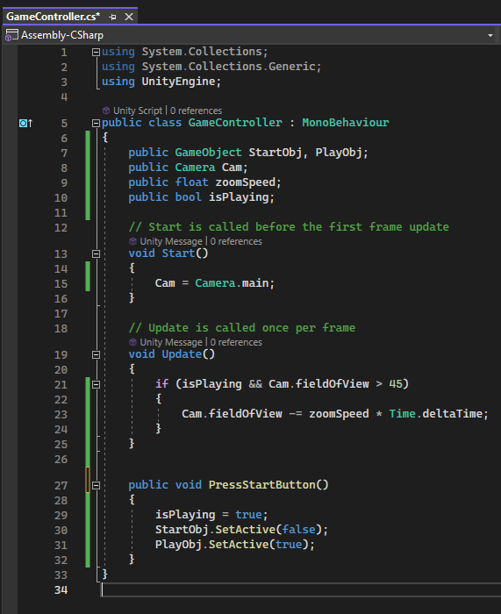
START BUTTON
Add a new script to the “Canvas” game object called “GameConroller”.

Slide 8
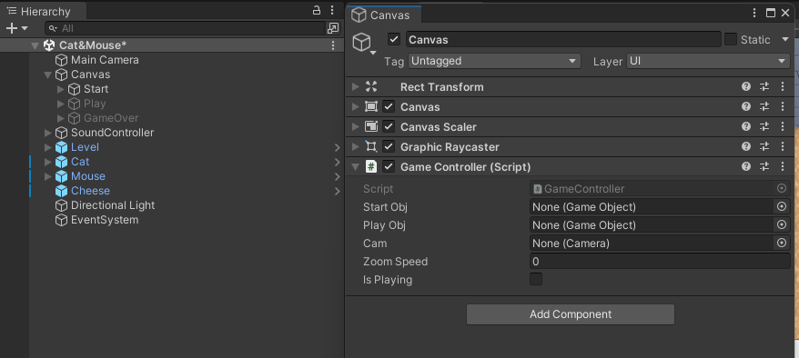
Right click the “Canvas” in the hierarchy and choose “properties”
Drag and drop the needed objects from the hierarchy to properties window to assign them
Adjust the zoomSpeed to 100
Close the “Canvas Properties” window

Slide 9
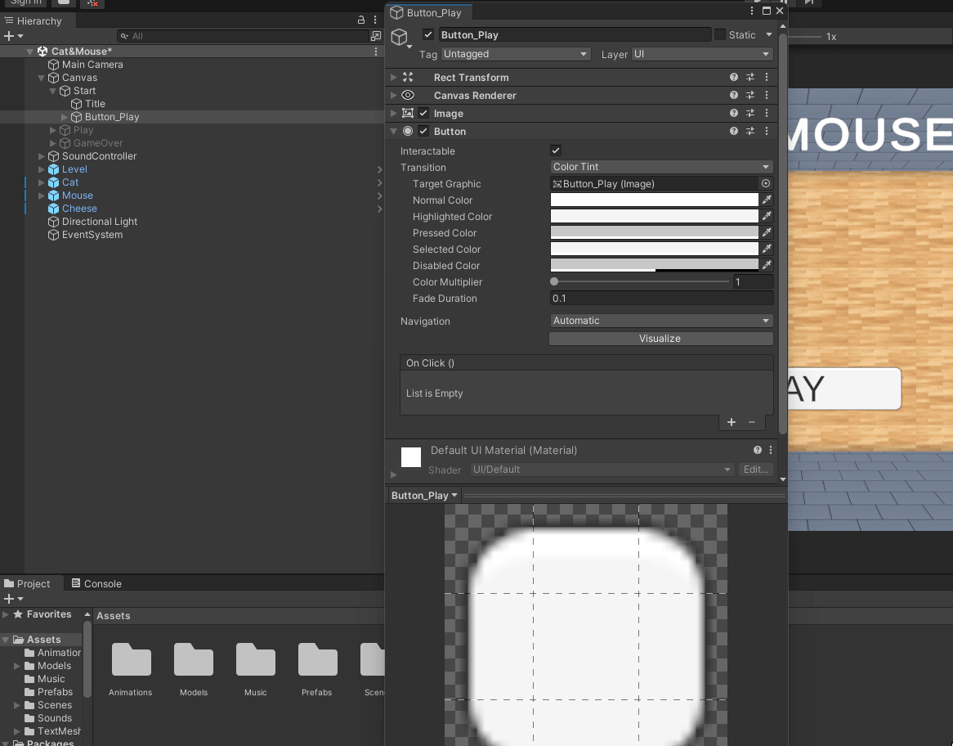
Select the Button_Play in the hierarchy, it is a child of the “Start” game object.
In the inspector window, find the “button” component. In the On Click() area, click the plus button.
Drag the “Canvas” object into the first box, then choose the “GameController” script from the drop down, selecting the “PressStartButton” function.

Slide 10
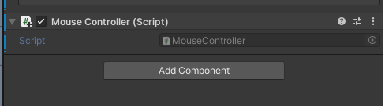
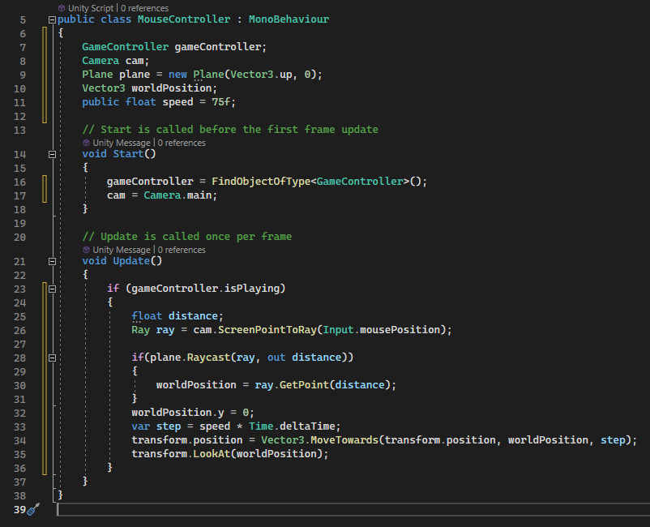
MOUSE FOLLOW CURSOR
Select the “Mouse” object in the hierarchy.
In the inspector, add a new script called “MouseController”
Add code to make the mouse look at and follow the mouse cursor

Slide 11
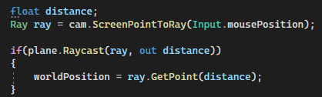
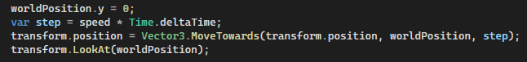
MOUSE FOLLOW CURSOR
Basically we are making a plane just like in scratch. With this plane created, we are casting a ray from the camera to the plane. We are then seeing how far from the center of the plane the mouse is (just like in scratch) Once we have this position, we can reset the Y value to zero so the position is not at the location of the camera and instead on the ground. Now that we have the position the mouse can move towards that point and make it look at that point.

Slide 12
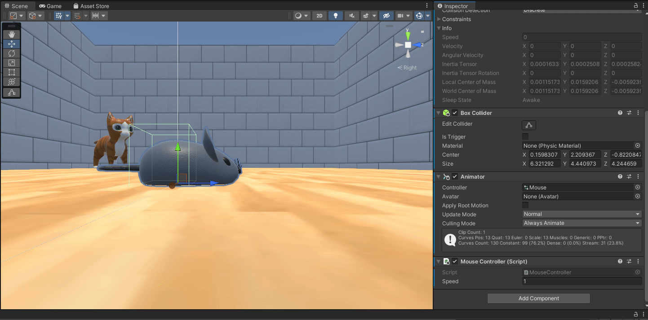
MOUSE COLLIDES WITH WALLS
Add a rigid body to the Mouse game object
Add a box collider to the Mouse game object
Use the edit collider button along with the ISO perspective to edit the box collider

Slide 13
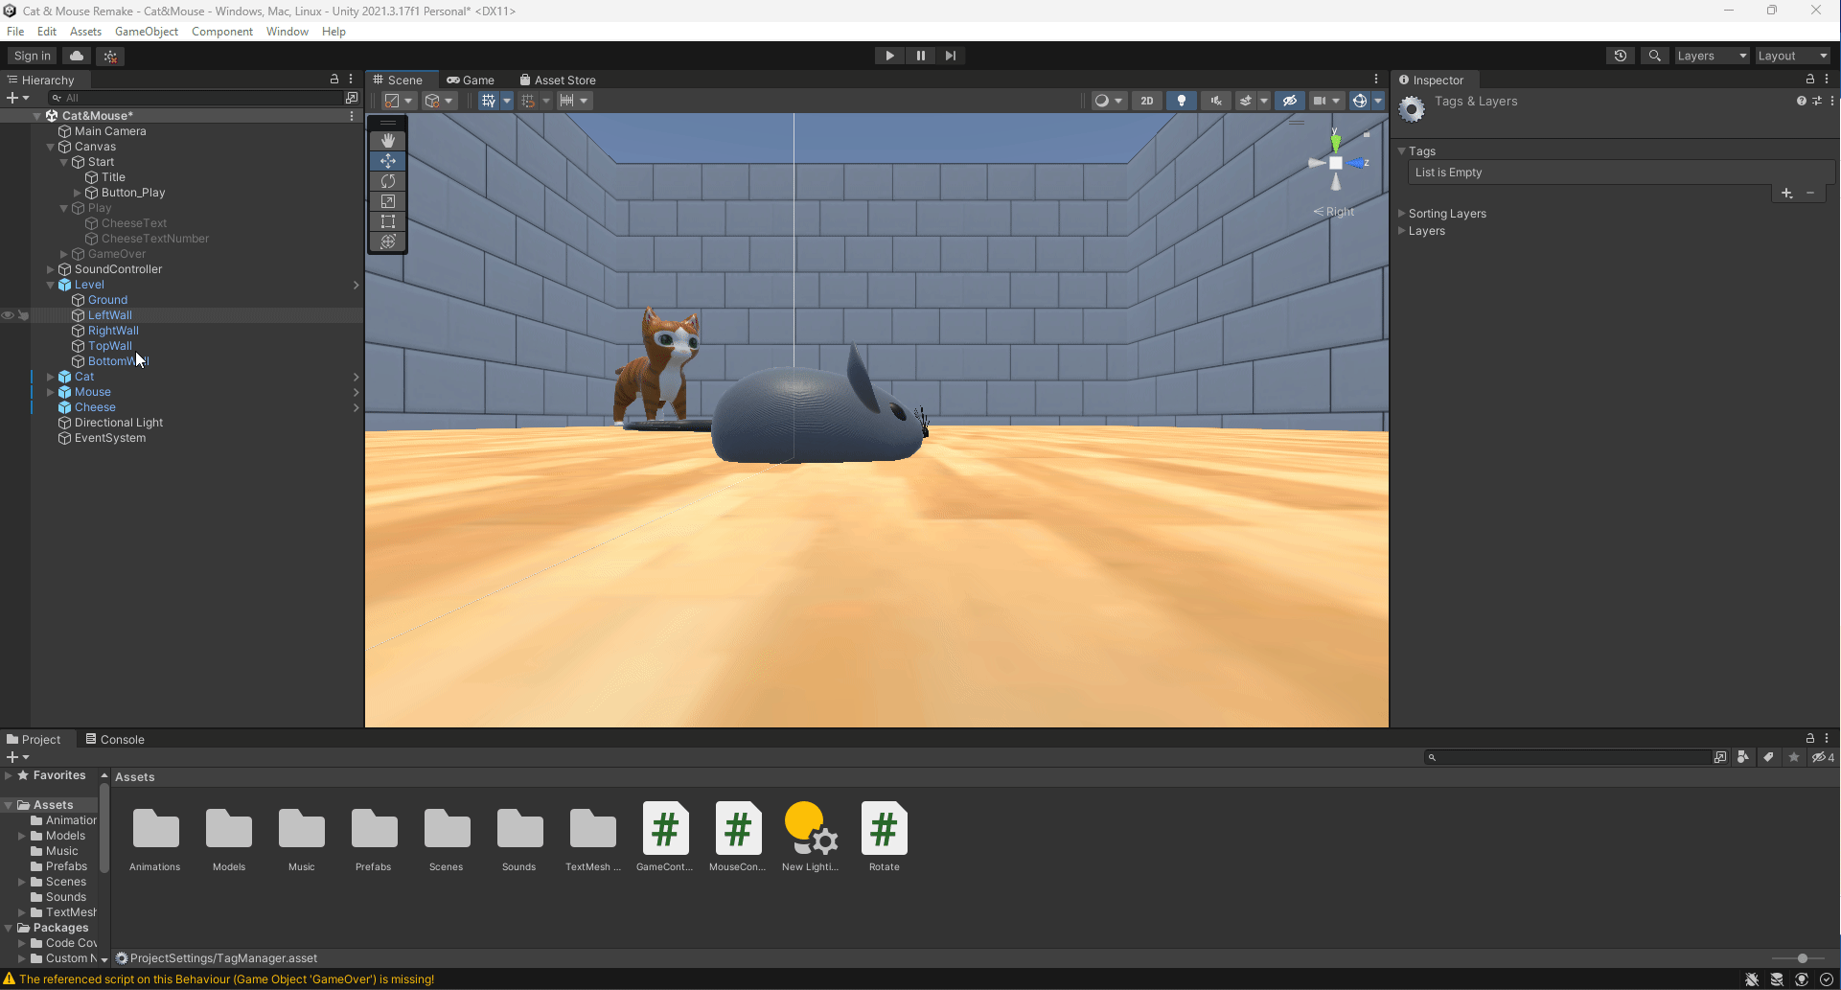
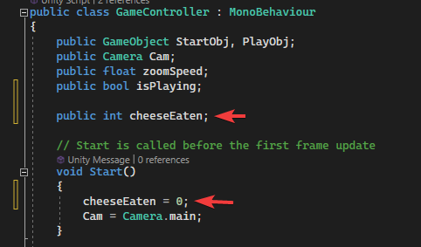
COLLECT CHEESE
Add a tag to the Cheese game object called “Cheese”
Add a box collider to the cheese
Add a variable in the GameController script for counting the cheese

Slide 14
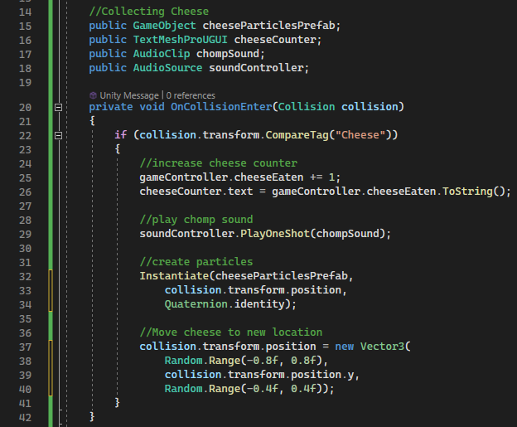
Add code to the MouseController. When the cheese is collided with
Create cheese particles prefab at location of cheese
Play the “chomp” sound
Move the cheese to a new location
Update the cheese counter

Slide 15
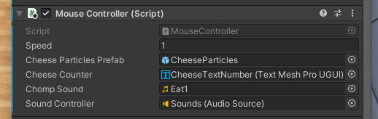
Make sure all of the references are added to the script
Drag the CheeseParticles prefab from the “Prefabs” folder into the Cheese Particles Prefab slot
Drag the CheeseTextNumber object from the hierarchy into the “Cheese Counter” slot
Drag the Eat1 sound from the “Sounds” folder into the “Chomp Sound” slot
Drag the “Sounds” game object from the hierarchy into the “Sound Controller” slot

Slide 16
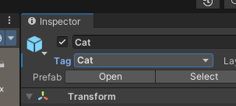
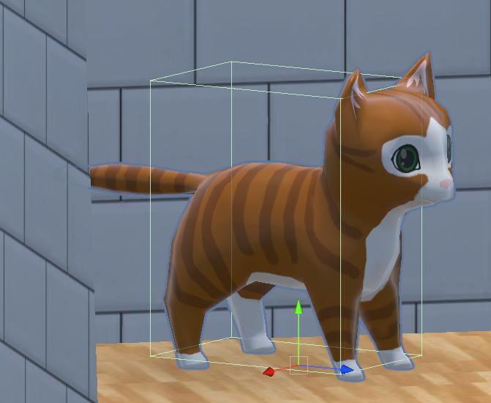
MOUSE TOUCHING CAT
Add a tag to the Cat game object called “Cat”
Add a box collider to the Cat. Use ISO camera mode to align the box properly.

Slide 17
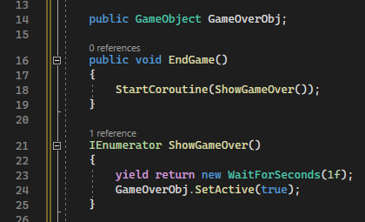
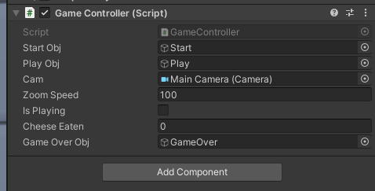
In the GameController script, add a coroutine and public method to start the coroutine. The goal is to show the game over screen after 1 second.
Assign the game over object to the script from the hierarchy

Slide 18
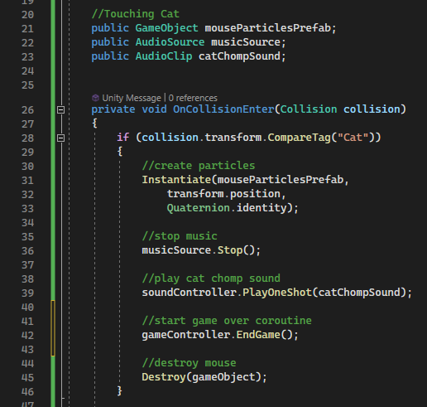
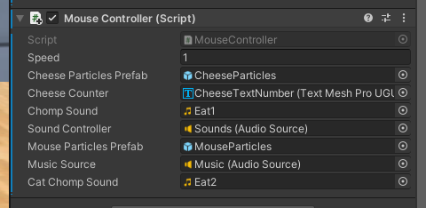
In the MouseController script, add new references and update the collision event.
Assign the references to the script

Slide 19
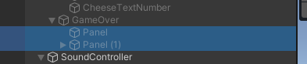
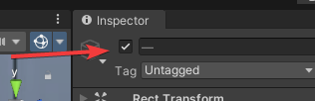
Make sure the panels that are children of the GameOver object are enabled.

Slide 20
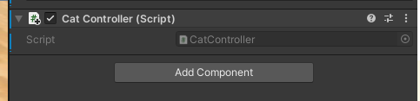
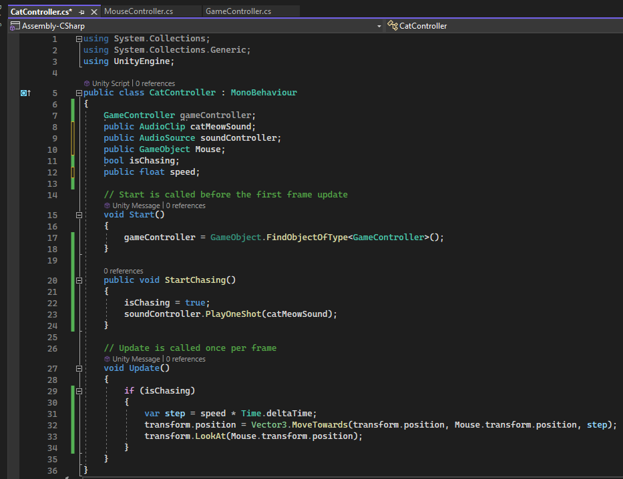
CAT CHASING MOUSE
Add a script to the Cat object called “CatController”
Add code to make the cat meow and start chasing the mouse

Slide 21
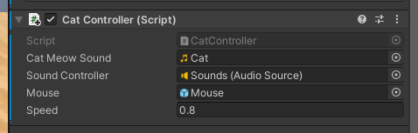
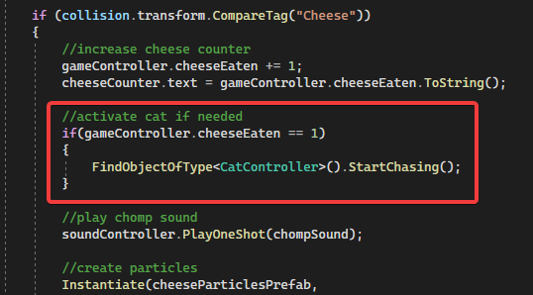
Assign the references to the script and set the speed to 0.8f
Add code to the MouseController cheese collision to call the method on the cat if the amount of cheese eaten == 1

Slide 22
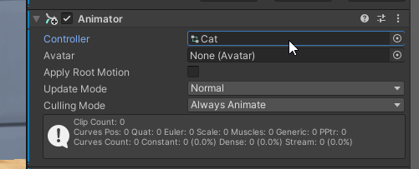
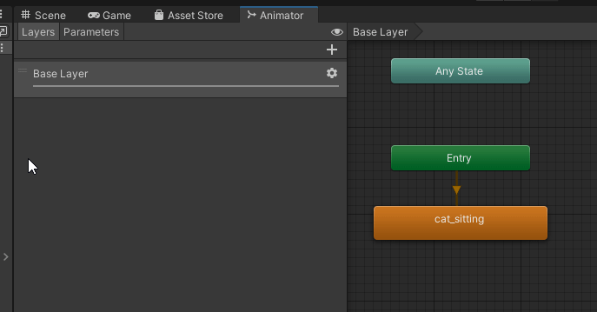
SET UP CAT ANIMATIONS
Open the Animation Controller by double clicking on it. This can be found in the Animator component on the Cat object.
With the Animator tab open, select the Parameters tab and add a new bool parameter called “chasing”

Slide 23
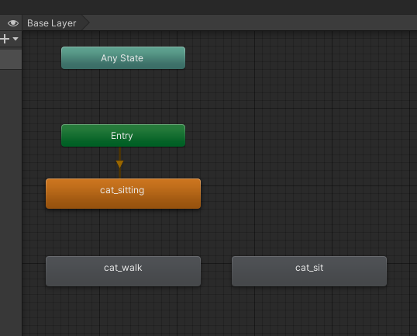
Drag and drop the “cat_walk” animation into the Animator window
Drag and drop the “cat_sit” animation into the Animator window

Slide 24
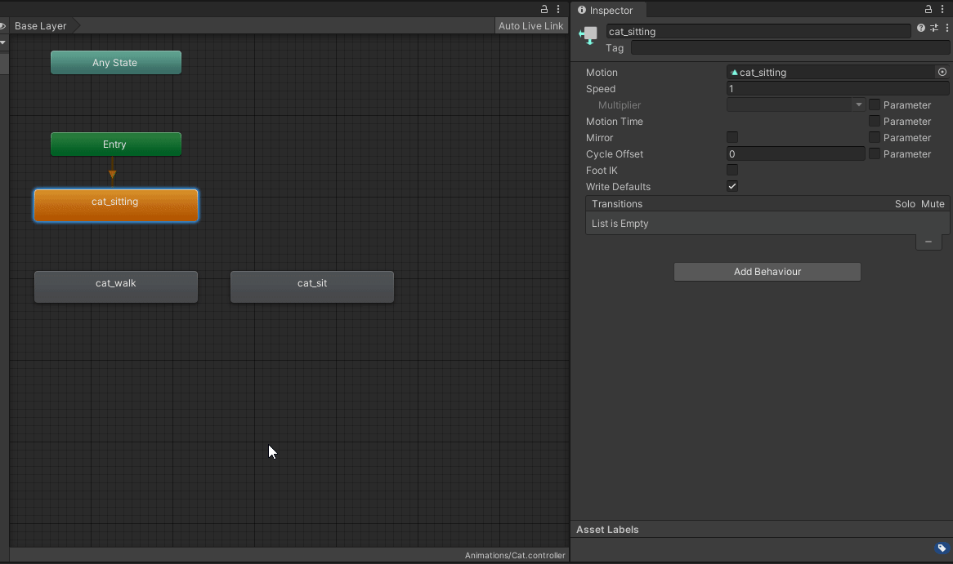
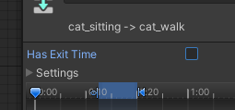
Make a transition from the “cat_sitting” to the “cat_walk” animation. Add the “chasing == true” condition to this link.
Turn off “Has Exit Time”

Slide 25
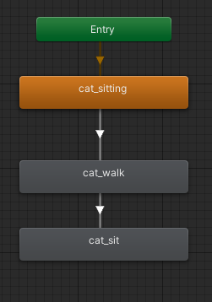
Make a transition from the “cat_walk” to the “cat_sit” animation. Add the “chasing == false” condition to this link. Also make sure “Has Exit Time” is turned off.

Slide 26
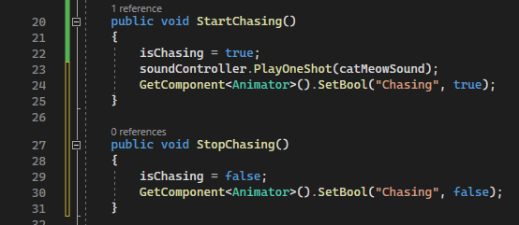
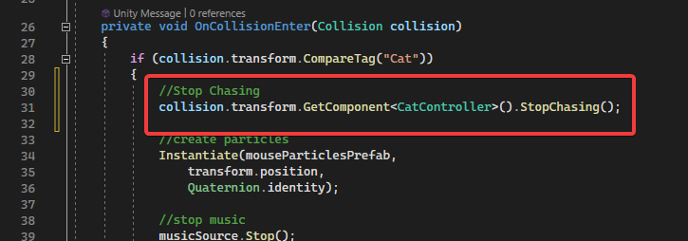
ACTIVATE CAT ANIMATIONS
In the CatController script, add a StopChasing() method and update the animations as needed.
In the MouseController script, activate the StopChasing function in the Cat controller

Slide 27
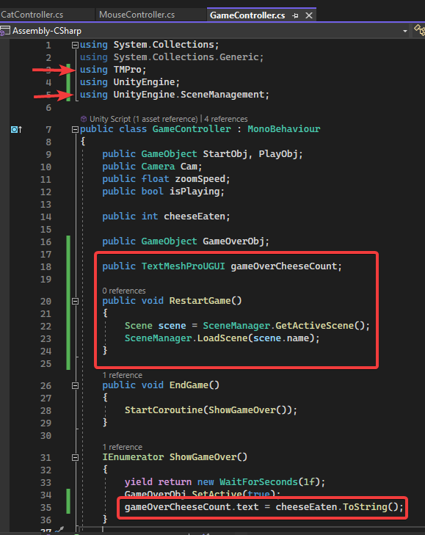
GAME OVER
In the GameController script, add a method to restart the game. Also, update the cheese count on the game over screen.

Slide 28
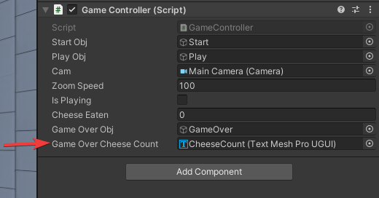
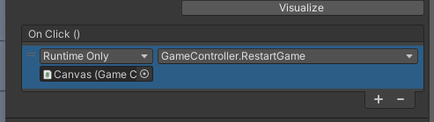
Assign the “CheeseCount” game object to the GameController script
Add the ability to restart the game with the “PlayAgainButton”

